Slide 1
Presence of Opioids in Wastewater
Drew Gobbi, Olivia Wang, Olatunji Akinbule, Maddie Warndorf
Internal Validity

Slide 2
The Causal Theory Underlying Our Analysis and the Proposed Causes/Proposed Effects
Causal Theory (from previous): Demographic features such as poverty status, whether a person is middle aged, education level, employment status, and household income may be associated with higher incidences of opioid use in census tracts within Tempe
Extract demographic features from american community survey 5 year estimates (ACS5) and regress on population normalized mass load (PNML) of opioid toxicity in wastewater to test this relationship
Stop short of calling this a causal analysis. We are looking for features that may be related to opioid use in order to identify at risk populations
Goal is to build foundation for targeting and testing specific interventions for at “at risk populations” in future research.

Slide 3
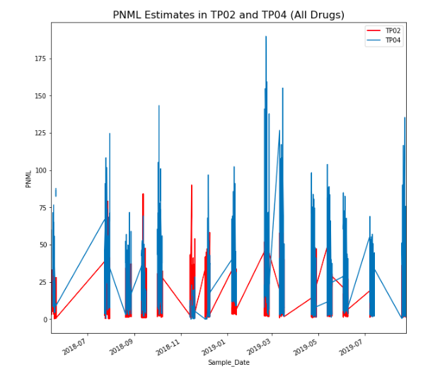
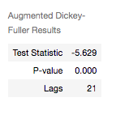
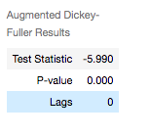
Pilot Data Demonstrating some Statistical Relationship
ADF TP02
Tested daily PNML time series
ADF tests show mean stationary for two of the collection areas (TP05 omitted from pilot due to measurement issue currently being resolved)
Observe some monthly cyclicality and overall spikes
Conclusion: time independence suggests OLS regression estimates are appropriate
ADF TP04

Slide 4
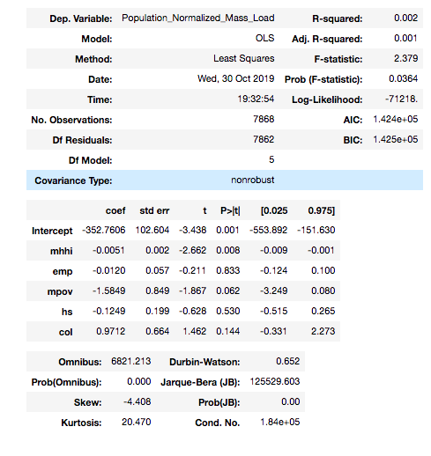
Pilot Data Demonstrating some Statistical Relationship
Based on hypothesis, tested the effect of ACS5 employment estimates, median household income, number of employed workers, and number of middle aged men and women earning up to 1.25 the poverty line
Find null results!

Slide 5
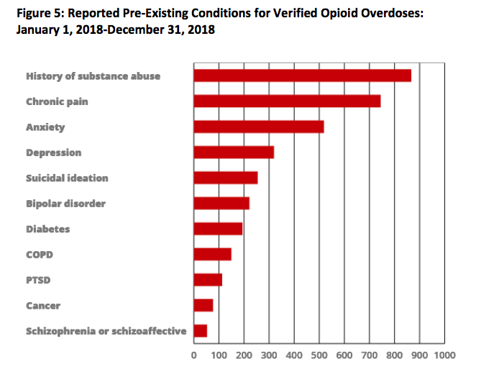
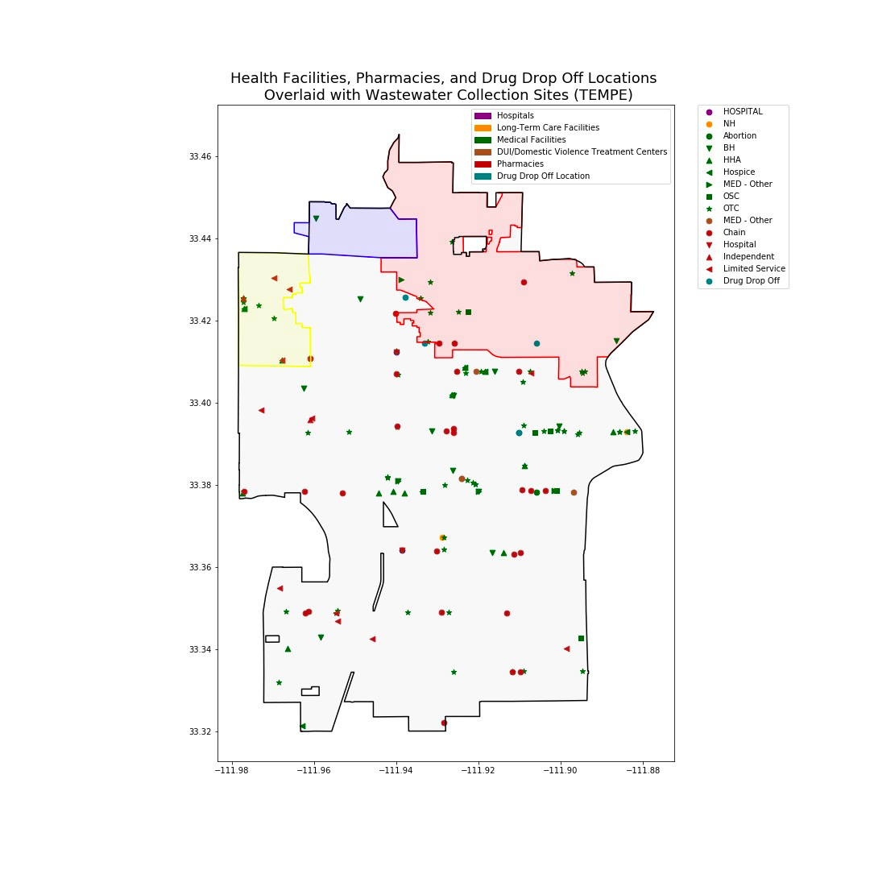
Pilot Data Demonstrating some Statistical Relationship - Proposed Solutions
Arizona Department of Public Health has found that mental health factors could affect Opioid overdoses (requested 2018 publication from AZ gov)
Also plan to examine spatial regressors for hospitals, treatment centers, and behavioral centers that we expect to be opioid deterrents or controls (have this data, but need to code/bin/implement into regressors)
Notes:
https://www.azdhs.gov/documents/prevention/womens-childrens-health/injury-prevention/opioid-prevention/opioid-response-report-2018.pdf

Slide 6
Whether Our Analysis is Susceptible for Each Type of Threat to Internal Validity
History Confound
Some degree of inter-day volatility, but high frequency estimates are time stationary suggesting no historical factor providing a confound
Maturation Confound
Lack of trend in PNML and stationarity suggest that there is no time-dependent generating process in our data
Testing Confound
N/A - Data are not being tested directly by this study
Notes:
Olivia

Slide 7
Instrumental Confound
Major threat to our analysis - PNML estimates may miss low quantities or certain types of drug use based on the way they are measured.
Because we do not directly control the source data and measurements there is an inherent and consistent instrumentation confound in our analysis.
Statistical Regression Confound
Estimates are relatively consistent (time-stationary mean) for years of data, suggesting no regression to mean
Experimental Mortality
Potential threat - could be migration (or death) of subjects out of sampling frame (Tempe) due to high drug usage in the city
We believe that this is unlikely to be an issue our time-frame is only a few years
Notes:
Olivia

Slide 8
Multi-Group Threats
No random assignment
Assume individuals of various characteristics are randomly distributed throughout tracts
Selection-X Threats
Selection-history, selection-maturation, selection testing, instrumentation, or regression threats are not threats to the study due to design
Selection-mortality is an issue - Subjects in high opioid use collection areas may have a greater incentive to move out of the sampling frame than subjects in other areas
Social Threats
Subjects in each collection group can not observe who is in which collection area and so they do not have an incentive to modify their behavior.
Notes:
Olivia

Slide 9
For Each Threat for Which Our Analysis is Susceptible, Indicate Whether that Threat is Plausible.
Instrumentation confound is a major issue with PNML estimates
Cannot mitigate this risk and have to accept
Other measures of drug use like EMS or Police calls have their own instrumentation confounds as well (drug use is hard to observe!). So we are assuming PNML instrumentation errors are at least no worse than the traditional measures
Experiment Mortality/Selection-Mortality
Plausible, but unlikely to be major population or demographic shift during the years we’ve observed that would affect our sampling frame
Other selection-x threats could be a potential issue due to spillover effects between geographic boundaries
Will attempt to control for this with spatial regressors (ex. Number of hospitals within 2 miles of census tract centroid.
Notes:
Olivia

Slide 10
Our Experimental Design to Rule Out Plausible Threats
In a perfect Tempe World, we would have all of the PNML for every tract. Then we would randomly assign which tract we would measure opioid usage based on PNML and randomly assign which tract we would measure opioid usage based on EMS Opioids Calls.
Posttest-Only Control Group Design
Randomly Assigned Tracts (R) | Opioid Data from Tracts Measured by PNML (New Opioid Measurements) Being Published (X) | Observe Community and City Policy Effects (O)
Randomly Assigned Tracts (R) | Opioid Data from Tracts Measured by EMS Opioid Call Data Being Published (Control because they have been publishing this data longer) | Observe Community and City Policy Effects (O)
Notes:
TJ

Slide 11
Random Assignment of Subjects?
Our study cannot randomly assign subjects because we have no control over which subjects live in which area
Our study does not need to randomly assign subjects because we are not directly introducing a treatment to the population.
Our objective is observing opioid use through the PNML or EMS estimates in a given area and noting what features of that area may be correlated with those opioid estimates.
Notes:
TJ

Slide 12
Plausible Threats to Internal Validity that We Are Unable to Address
Without random assignment to a subsample to a specific intervention, any association we observe is assumed to be merely suggestive and not causal.
Potential self-selection of the population into the census tracts in Tempe we are observing. This may bias our estimates.
Susceptible to potential spillover effects between watersheds in the collection areas that may over or understate the effects of a given characteristic on opiate use in the census tracts.
Inability to distinguish between prescribed and unprescribed use of opioids in our PNML estimates because we are only observing total usage in the city wastewater.
Notes:
TJ

Slide 13
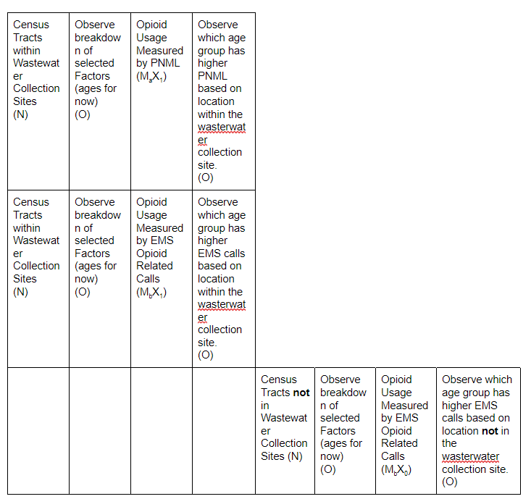
Combination of Quasi-Experimental Designs to Mitigate the Remaining Threats to Internal Validity
Proposed Design: Equivalent materials quasi-experimental design (w/spatial regression)
Test the effects of the same demographic or health predictors (X1, X2,...)on different measures (PNML, EMS calls, etc. ) of opioid use such as the PNML wastewater estimates and the EMS call data.
A determination of a consistent relationship between the same group of certain community factors and different proxies for opioid can help bolster our claim that these risk factors are enduring
Assumes EMS, PNML, other measures have a 1:1 representation with Opioid use/users (weak assumption)
Notes:
TJ

Slide 14
How We Would Rule Out Other Measures the size of these remaining threats.
Instrumentation Confound
Assessing the size of instrumentation with potentially other available data e.g research that has already been conducted related to the level of supervised/subscribed opioid use related to each facility type
Contacting ASU Researchers to ask them about their methods and threshold to cross-reference research done regarding the measurements of wastewater opioid data and their accuracies to measure the size of the instrumentation confound.
Experimental Mortality
monitoring the census data overlaid with the census tracts to closely monitor the change in population in different areas.
census is not collected in the same frequency as the wastewater opioid detection, we will have to make sure that they are on the same frame. Or, if the census data show that in the long run, the population in each and all areas are largely consistent
Notes:
TJ

Slide 15
Our Proposed Experimental or Quasi-Experimental Design on Pilot Data

Slide 16
For PNML within Collection Sites

Slide 17
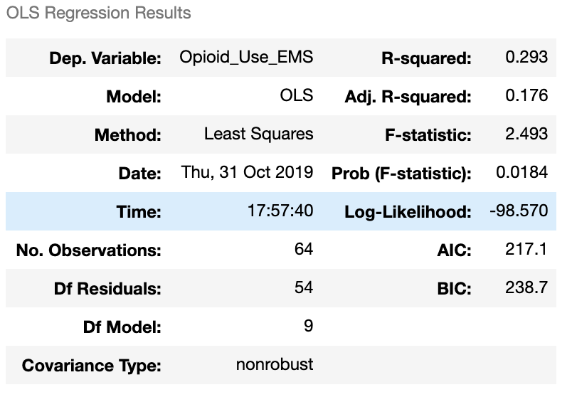
For EMS Opioid Calls within Collection Sites
Census Tracts within Wastewater Collection Sites (N) | Observe breakdown of selected Factors (ages for now) (O) | Opioid Usage Measured by EMS Opioid Related Calls (M_{b}X₁) | Observe which age group has higher EMS calls based on location within the wastewater collection site. (O)
Area 2
No regressors are statistically significant

Slide 18
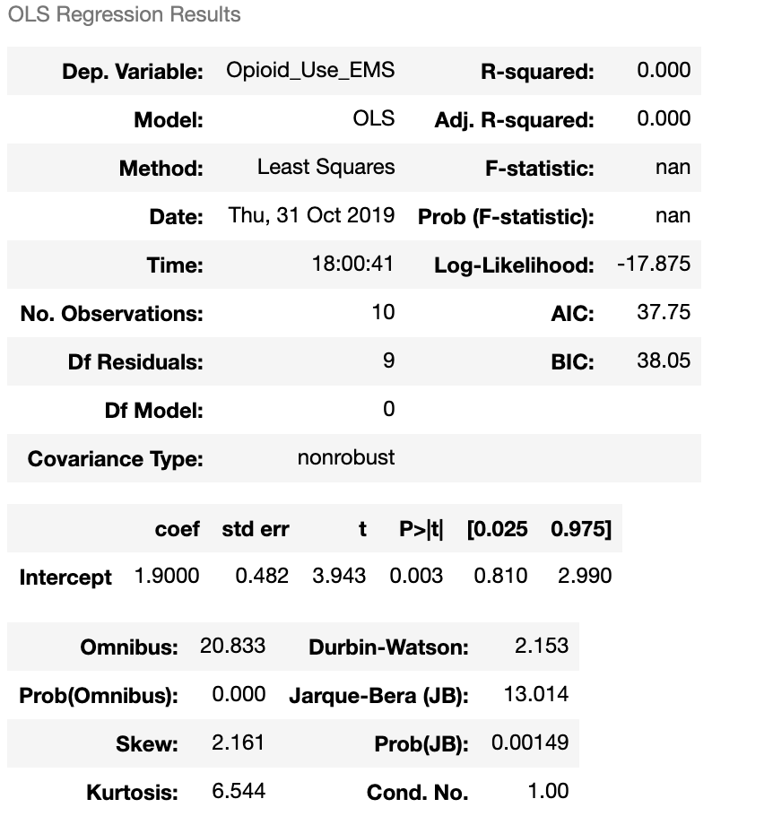
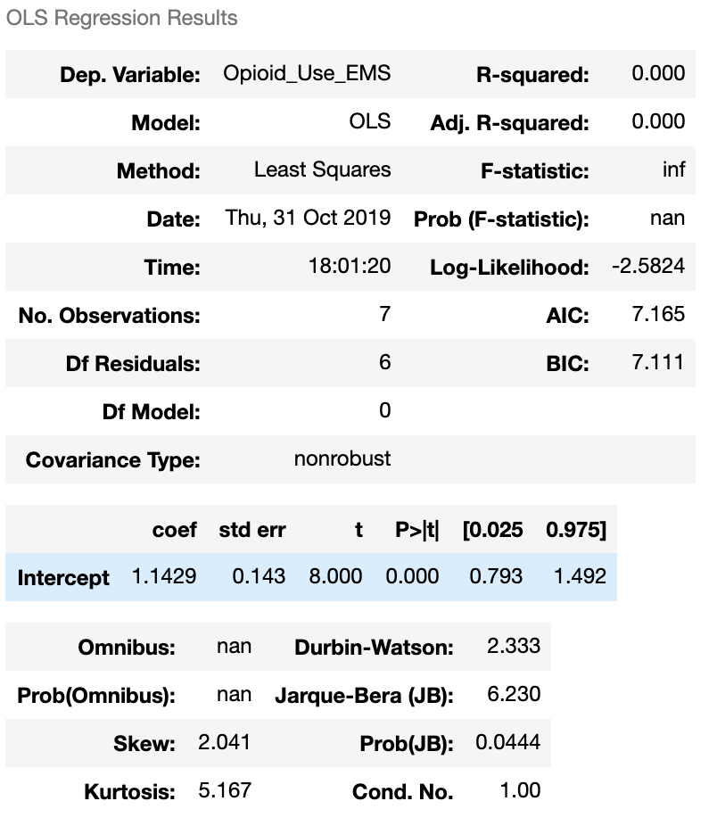
Area 4 Area 5
No regressors are statistically significant

Slide 19
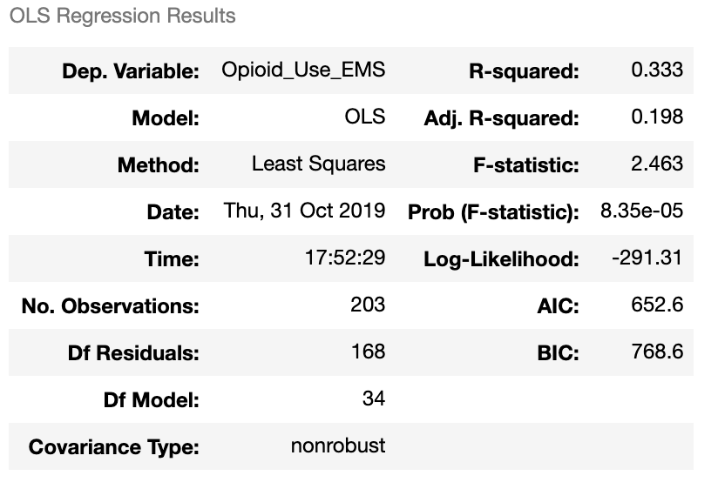
For EMS Opioid Calls in Non-Collection Sites
Census Tracts not in Wastewater Collection Sites (N) | Observe breakdown of selected Factors (ages for now) (O) | Opioid Usage Measured by EMS Opioid Related Calls (M_{b}X₀) | Observe which age group has higher EMS calls based on location not in the wastewater collection site. (O)
No regressors are statistically significant

